Slide 1
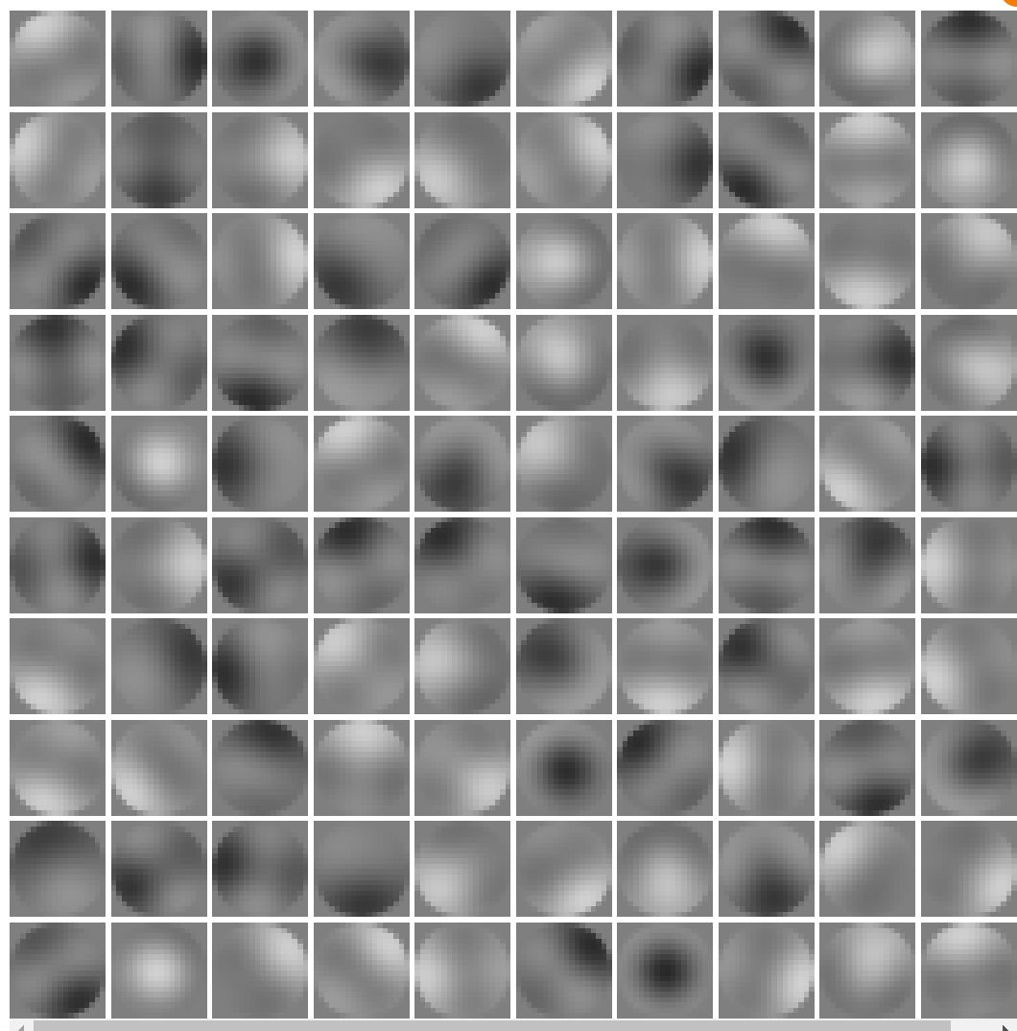
Last week
- New constraint method where bias and threshold are learned through gradient descent
- Doesn’t work

Slide 2
This week
1- Increase Firing rate constraint learning rate : 1x, 0.1x, 0.01x
2- New metrics for Lagrange and Two_losses
Gradient
Covariance matrices
3- Recording loss before and after adjusting FR
4- Toy model
5- Next steps

Slide 3
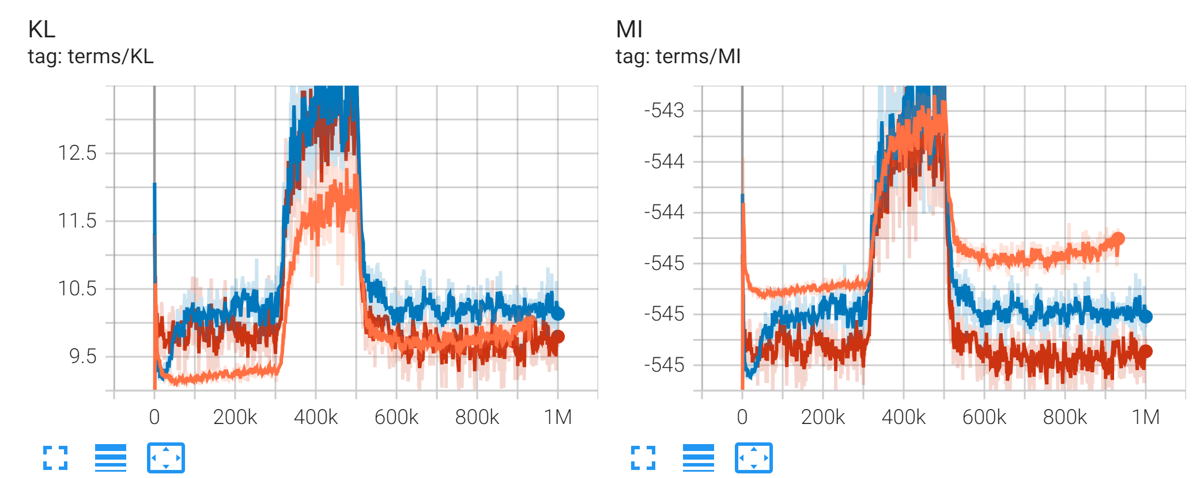
Increasing the LR of the FR constraint

Slide 4

What is the difference between KL and MI? (Question from last week)
KL:
MI:

Slide 5
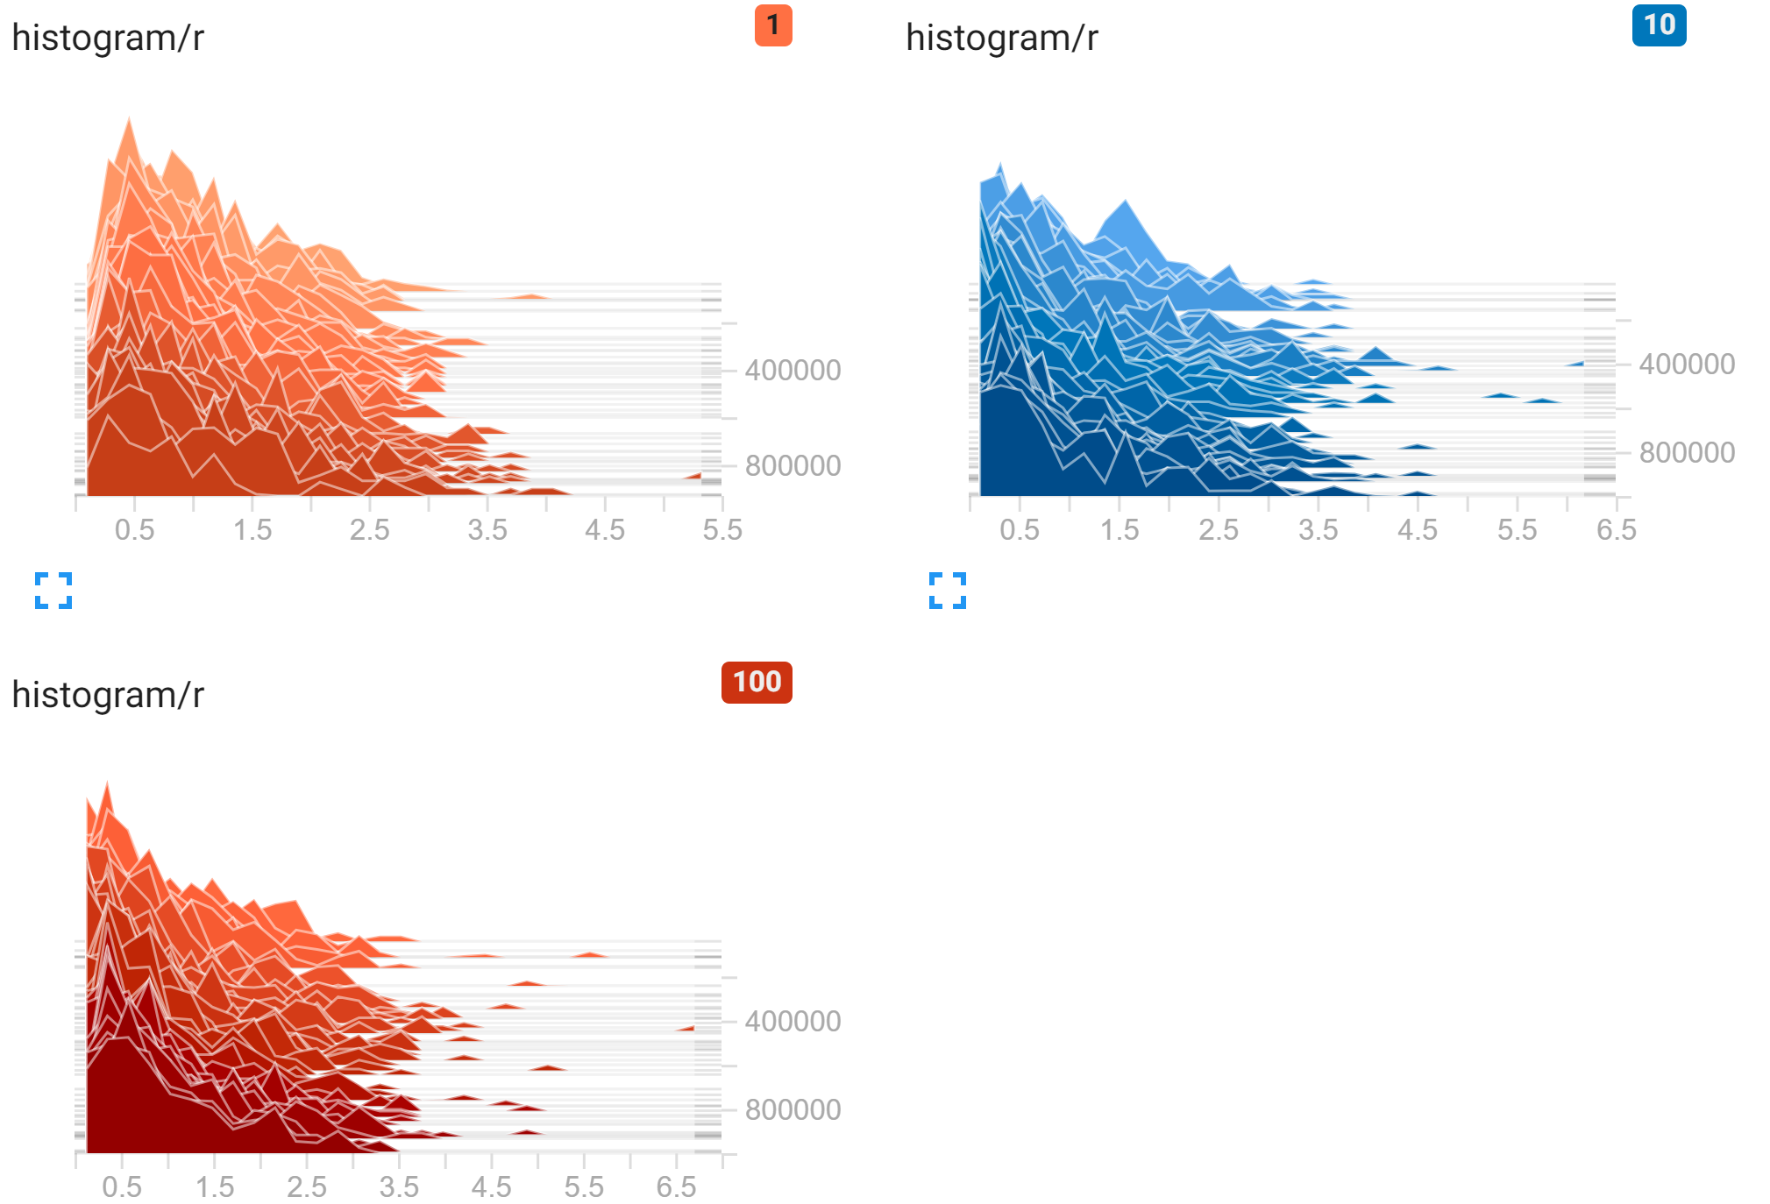
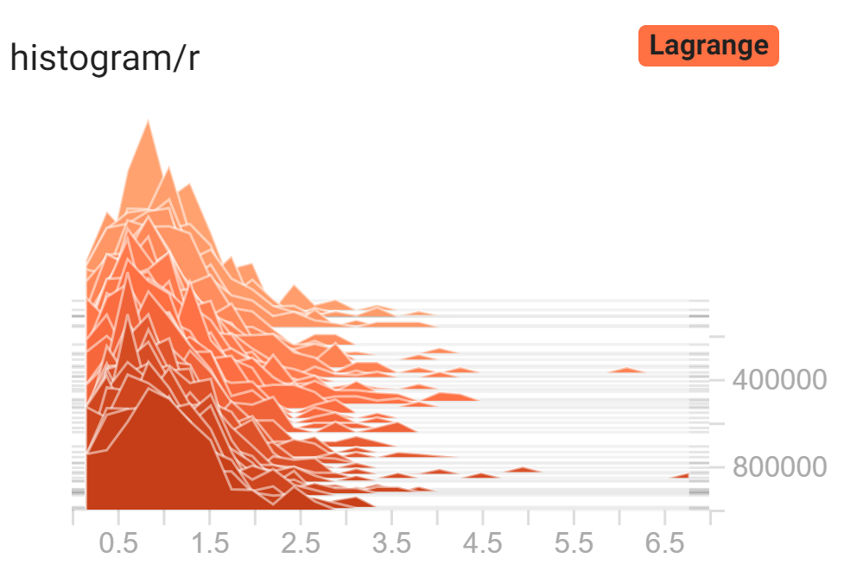
Increasing LR for FR doesn’t narrow the distribution of firing rates
Lagrange FR histogram for comparison:

Slide 6
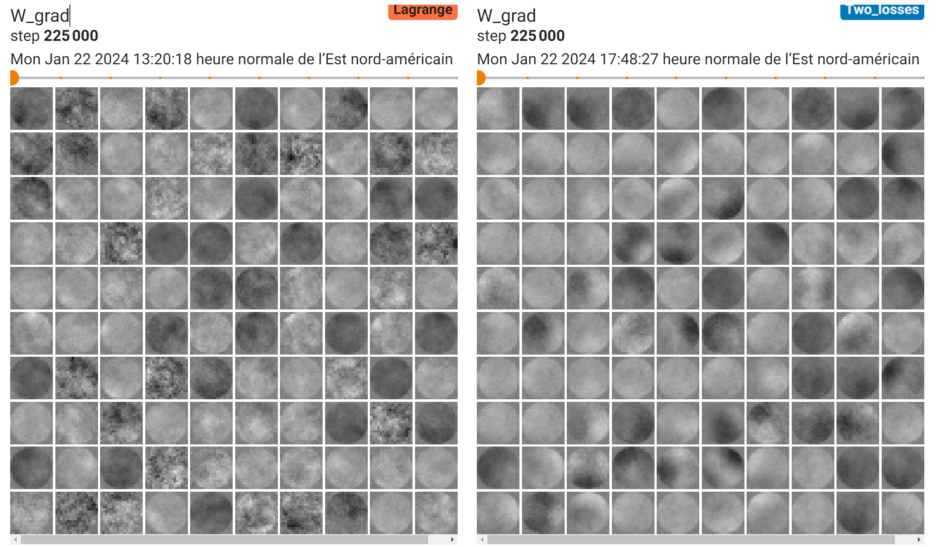
New Gradient metric: Lagrange vs Gamma

Slide 7
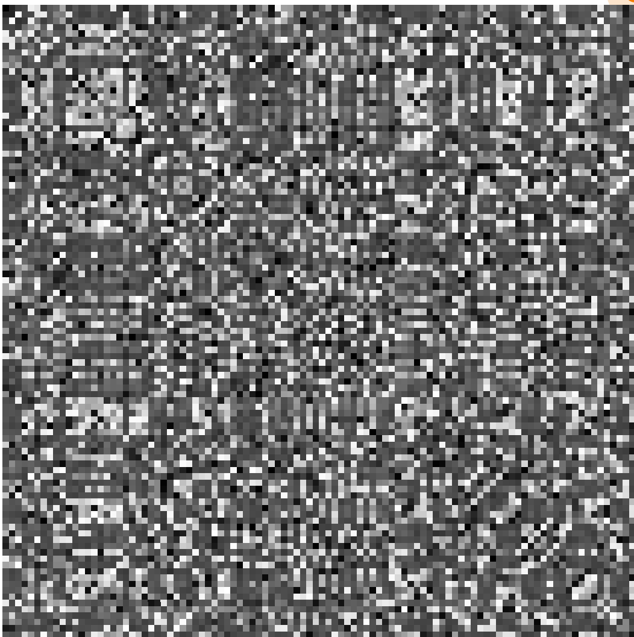
Previous (Lagrange) covariance matrix: Doesn’t look like it should
Reasons why:
John: Should be diagonal if we don’t
multiply by G matrix
David: This is taken from 1 batch of 128
Maybe this is a noisy estimate

Slide 8
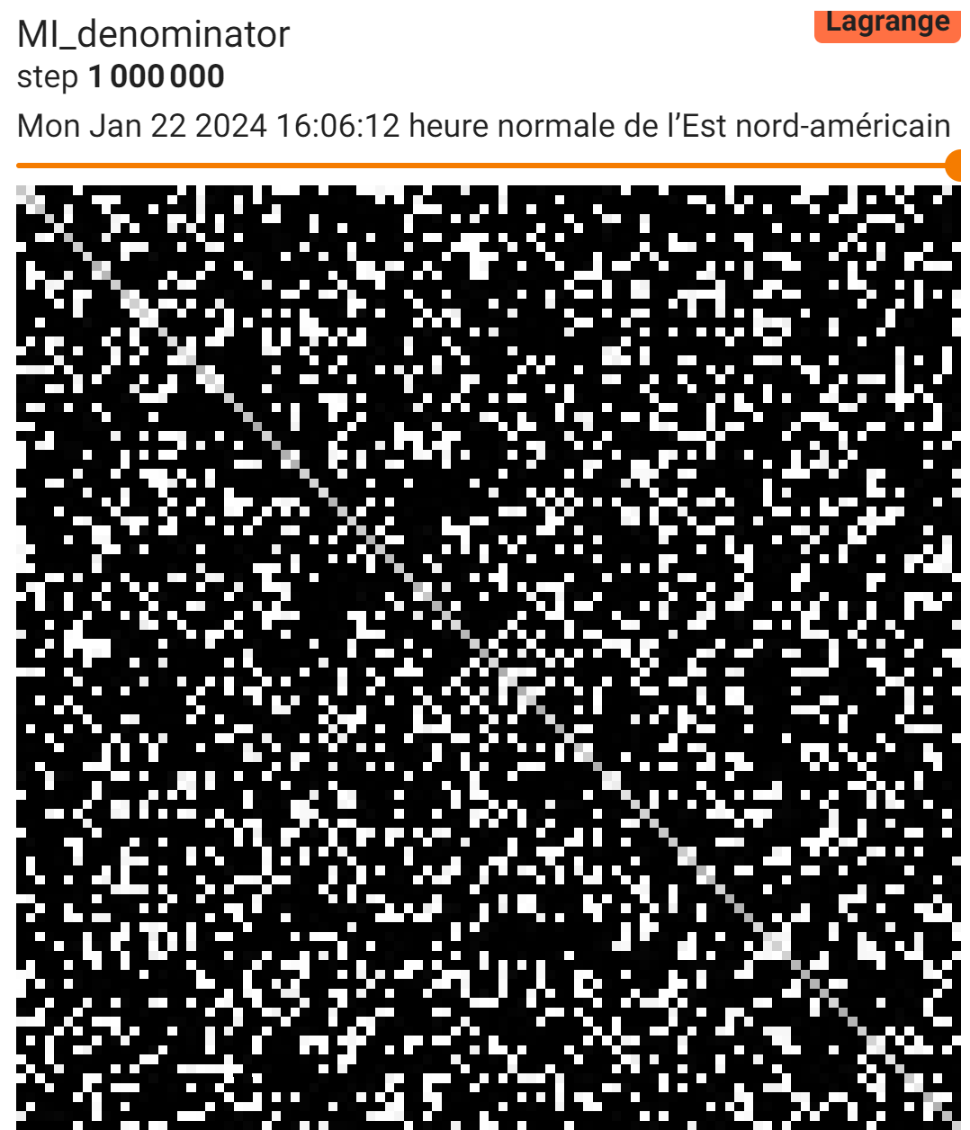
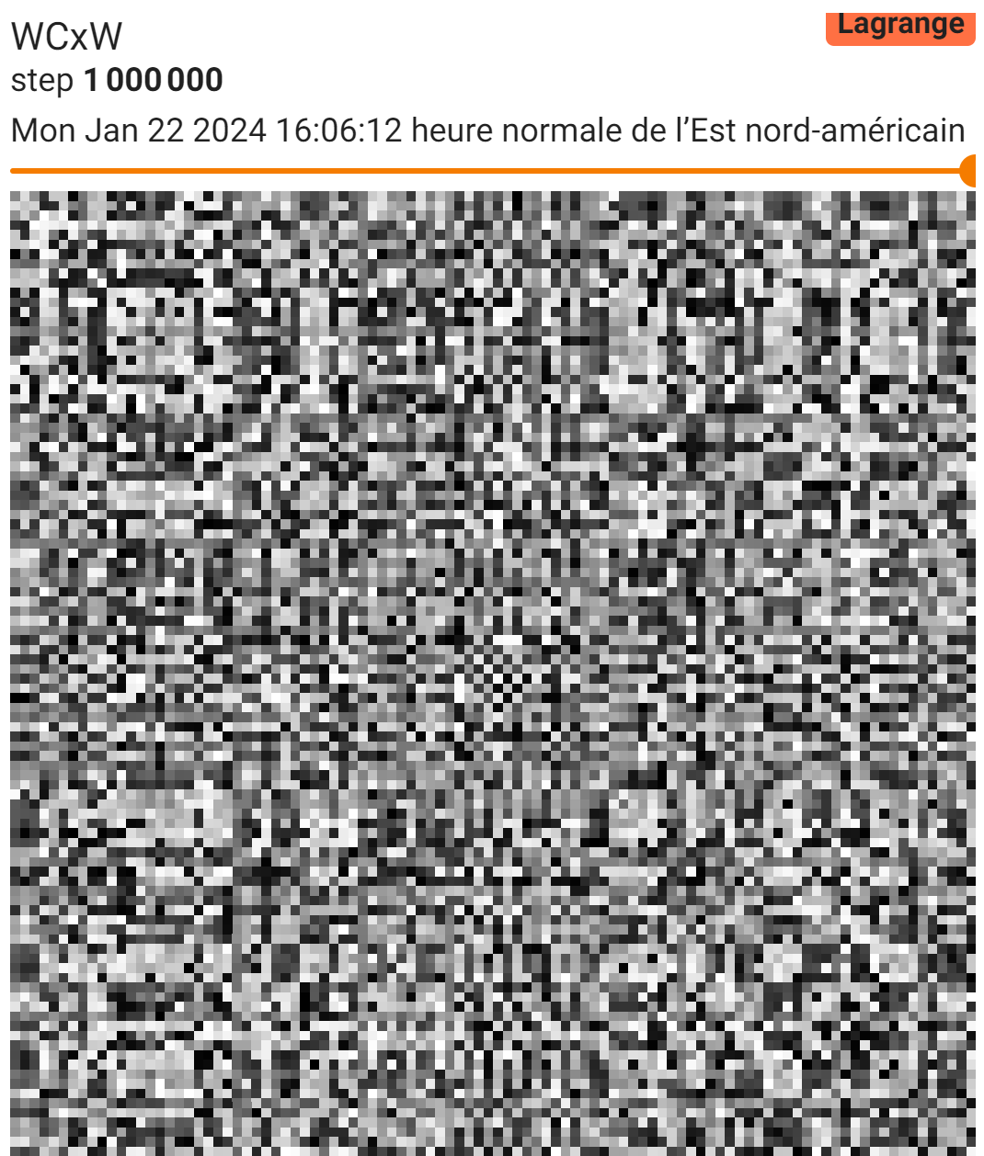
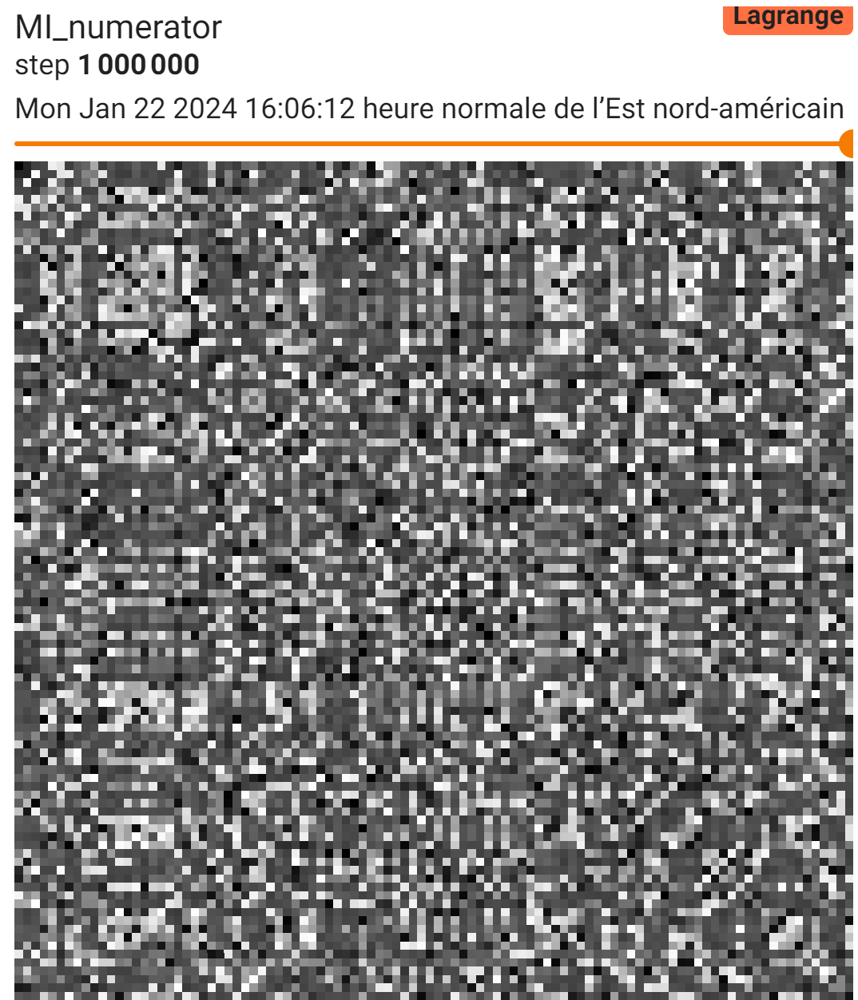
Both hypotheses seem to be wrong
Sampled from 1000 batches instead of just 1:

Slide 9
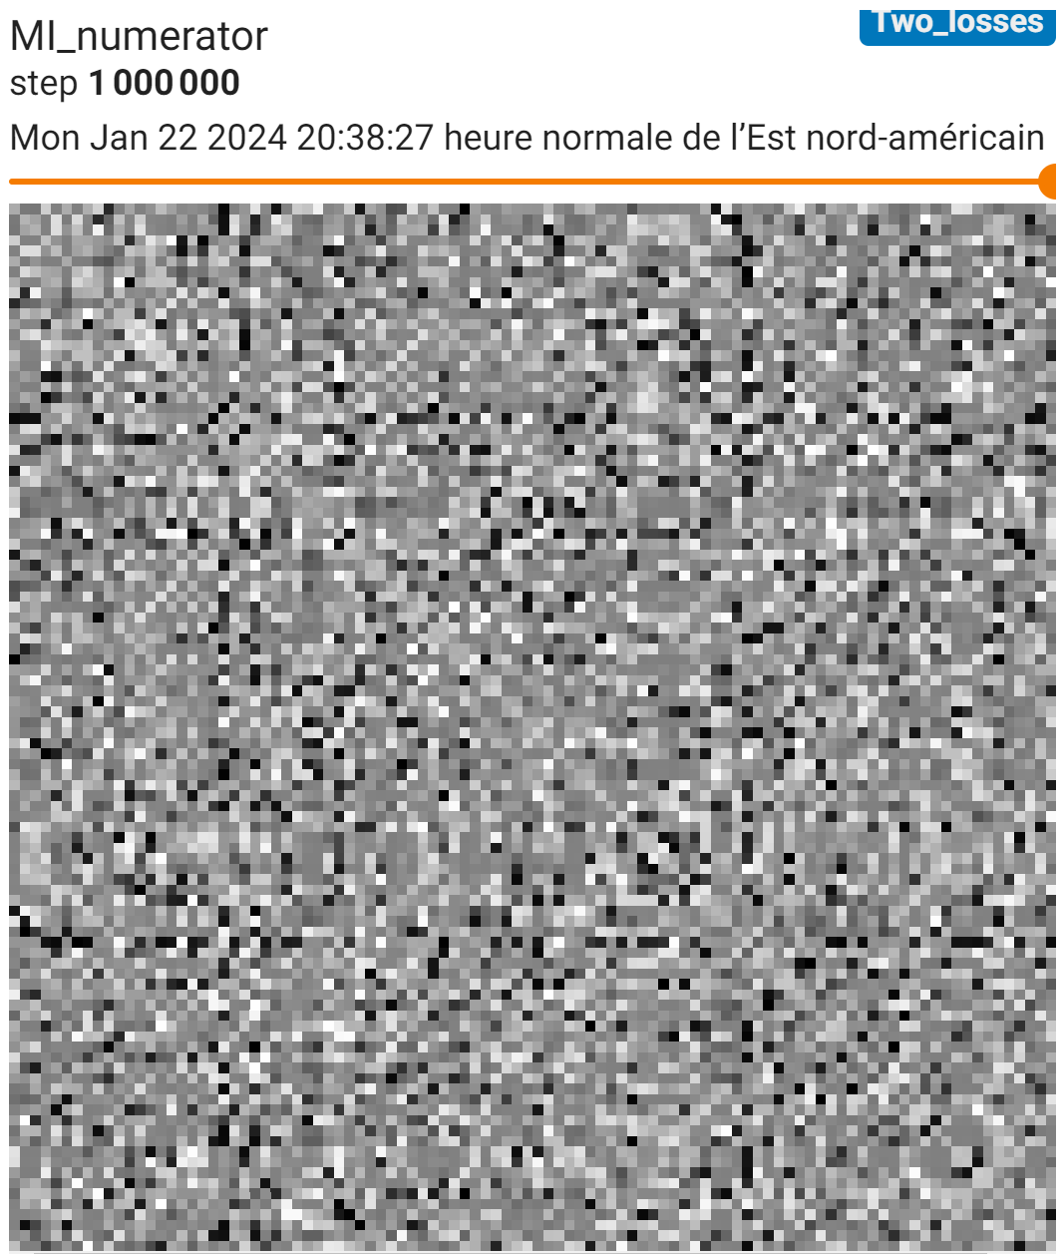
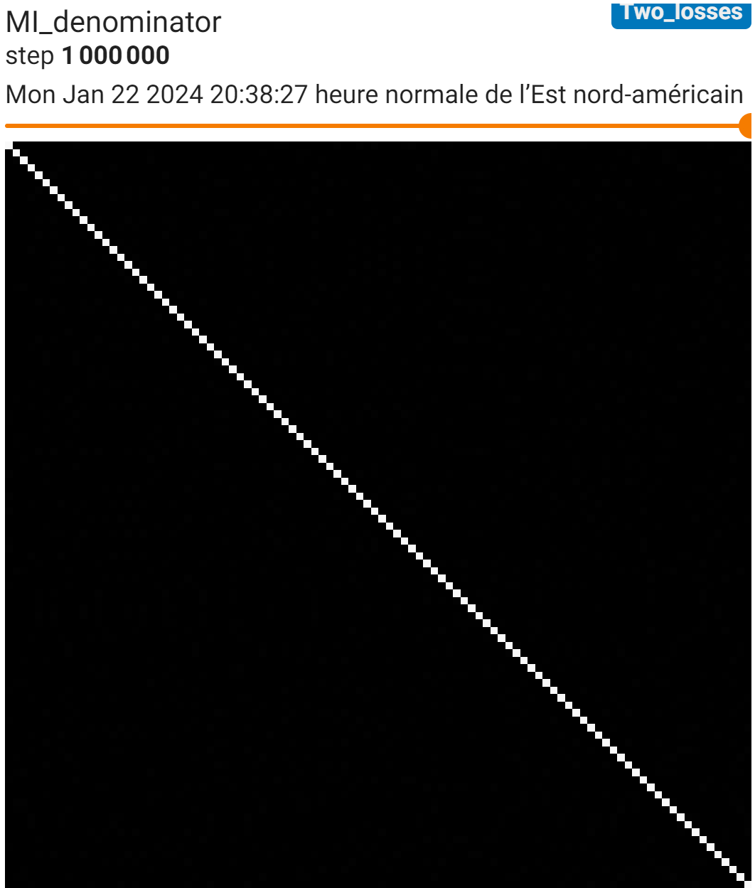
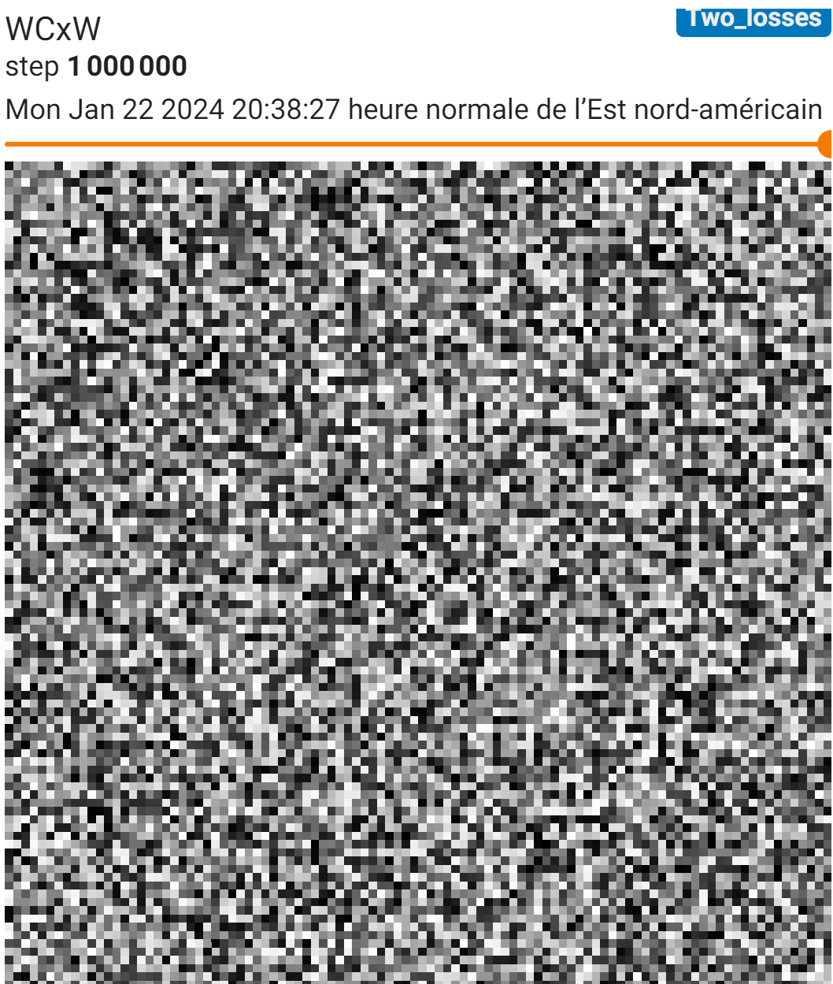
Ironically, these matrices look better with Gamma method

Slide 10
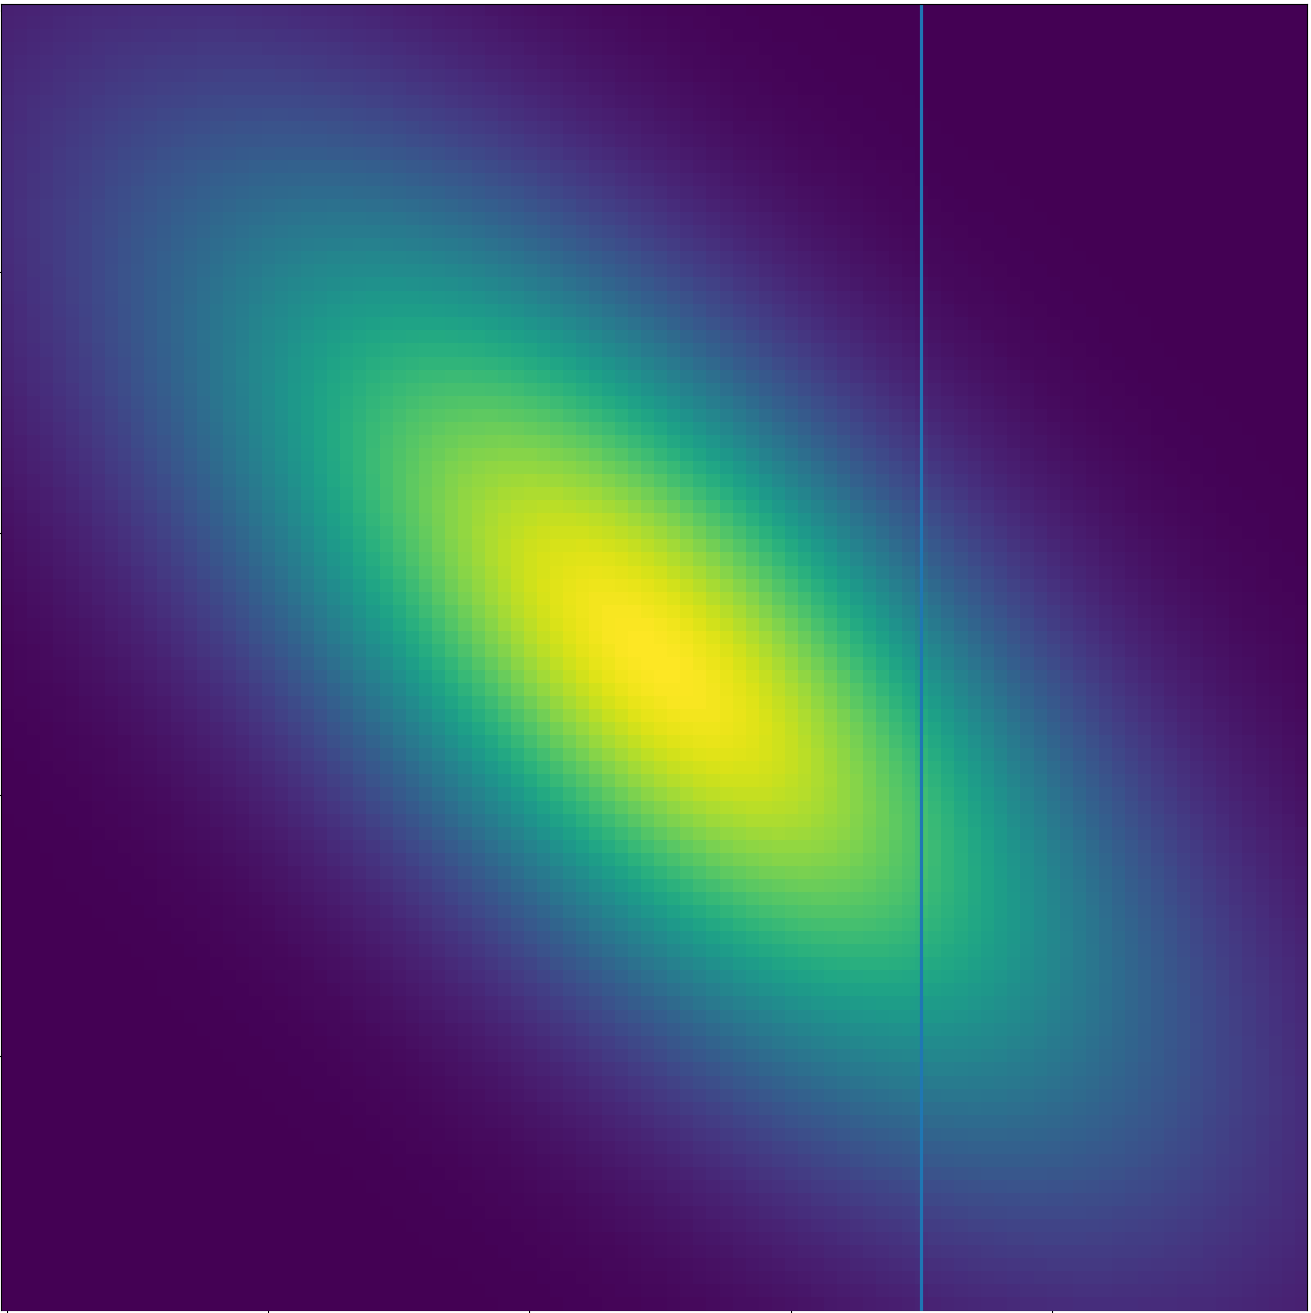
Why doesn’t this work? Toy problem with a 2D multivariate oriented gaussian

Slide 11
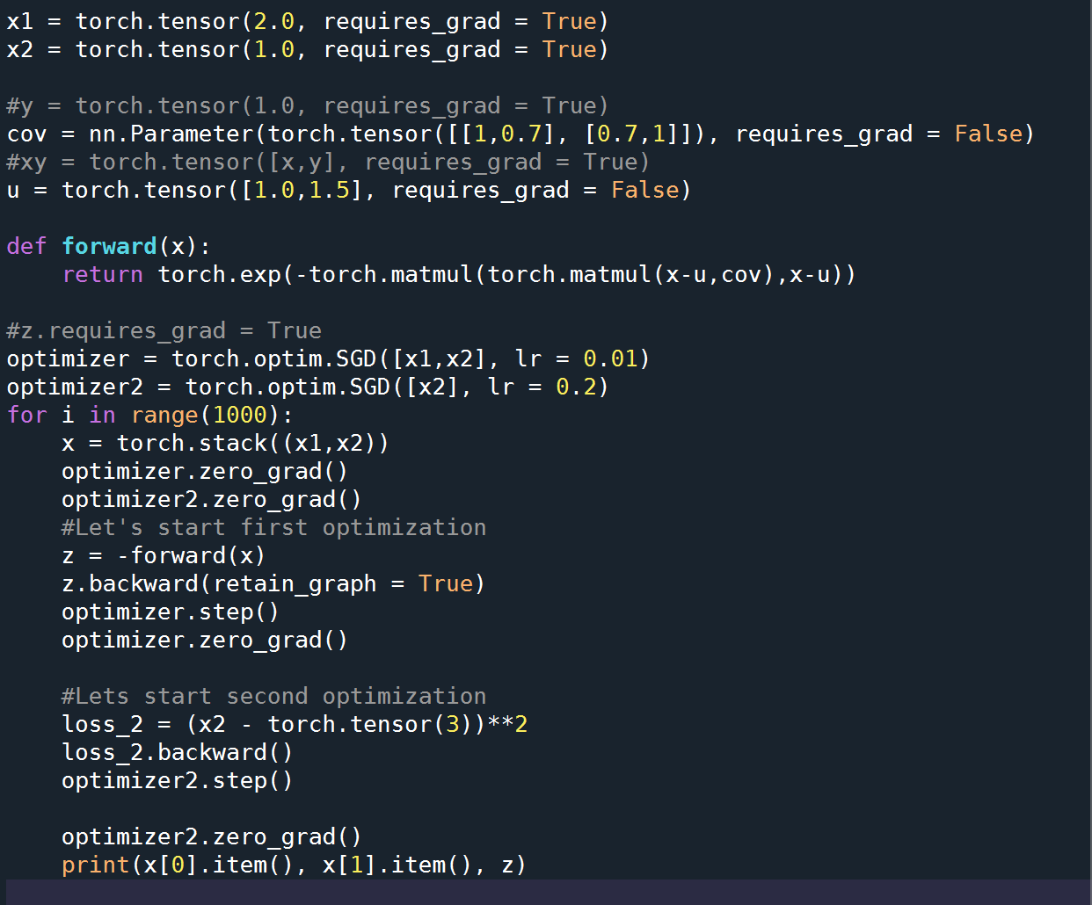

Slide 12
Results in a nutshell
1- I initially thought I could replicate the failure mode but turns out that was because I didn’t let the algorithm run for long enough
2- This toy model works (As long as initial conditions aren’t too far off from optimum)
3- I still don’t know why the Gamma method doesn’t, but that’s okay

Slide 13
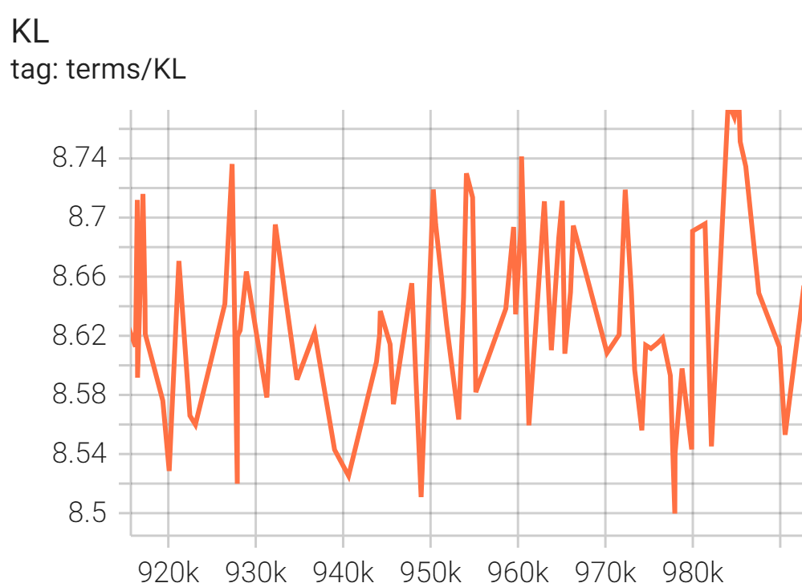
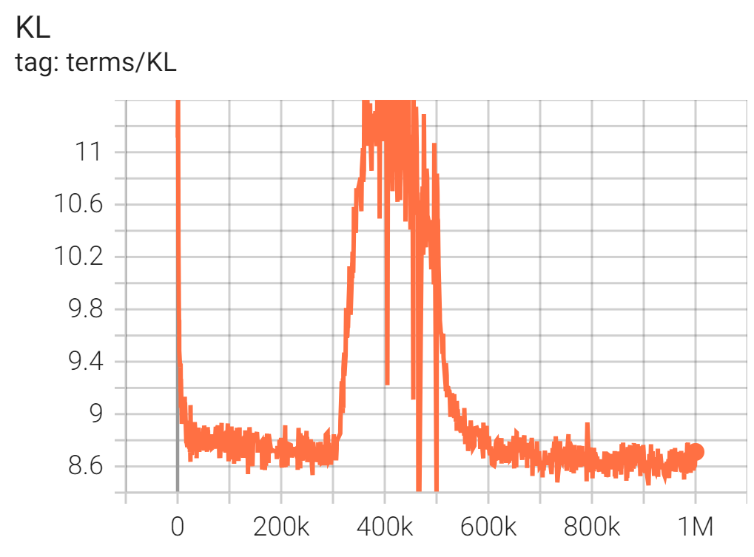
Recording KL before and after adjusting the firing rate

Slide 14
Ideas
Back to 300x300 color model but with a learning rate that reduces over time (currently running)
Figure out where algorithm takes most time to run. LU decomposition to optimize learning?
In general, figure out how to make 300x300 model converge better

